Slide 1



INFORMS RAS 2025 Problem Solving Competition
Predictive Maintenance for Railway Wheelsets
Team Name: Rail@iitk
Team Members
Dr. Faiz Hamid – Associate Professor, Dept. of Management Sciences
Krishan Kumar – M.Tech student, Dept. of Management Sciences
A Saiprabhav Reddy – B.Tech student, Dept. of Computer Science & Engg.
Indian Institute of Technology Kanpur
Notes:
Hello — we are Team Rail IITK. I’m Krishan Kumar, M.Tech, Department of Management Sciences, IIT Kanpur. Today I’ll present our INFORMS RAS 2025 solution on Predictive Maintenance for Railway Wheelsets.…

Slide 2
Presentation Overview
01
02
Introduction & Problem Statement
Failure Types
Setting the foundation for predictive maintenance in railway systems
Classification of failures – multiclass problem
03
04
Data Overview
Data Analysis
Comprehensive overview of historical railway data
Data cleaning, preprocessing, EDA, Feature engineering
05
06
Solution Approach
Maintenance Recommendations
Model development and implementation strategy
Key findings and predictive outcomes

Slide 3
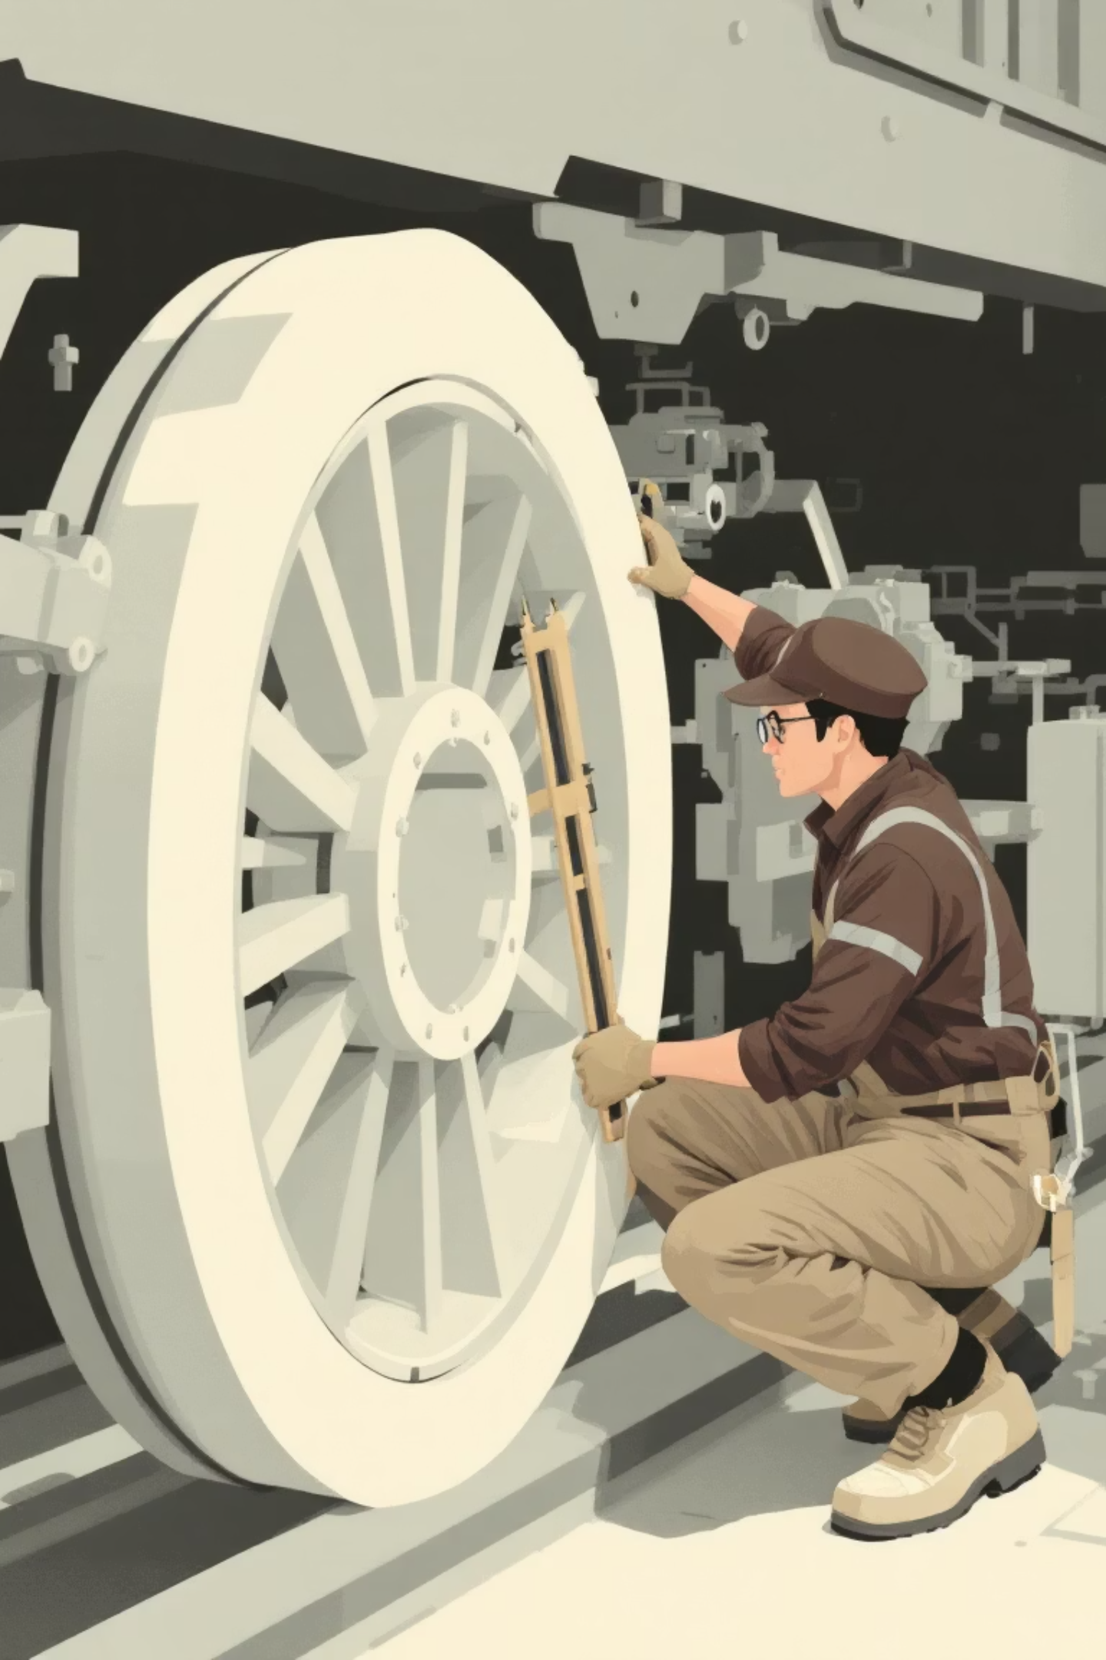
Introduction
Railway wheelsets are critical safety components requiring proactive maintenance to prevent catastrophic failures and ensure operational continuity
Problem Statement
Predict wheel failure type within the next 30 days using historical sensor data, mileage records, and railcar attributes
Notes:
Wheelsets are critical for safety and ride quality. Small defects — flange wear, thinning, or impact damage — can cause derailments and high cost. Traditional maintenance is reactive or fixed-interval and often mistimed. Our objective: predict the probability of different failure reasons up to 30 days ahead, using multi-sensor and operational data, to enable condition-based maintenance.

Slide 4
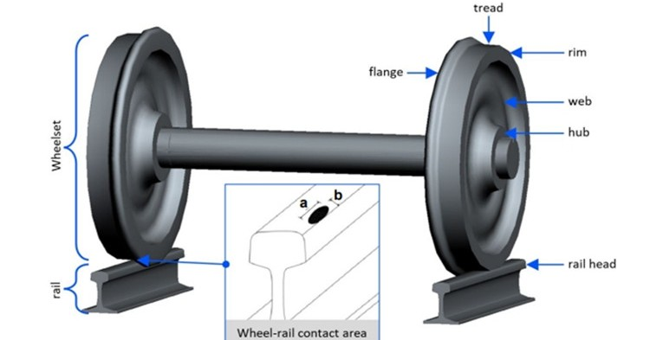

Types of Failure
High Flange
Excessive wear on wheel flange causing derailment risk through compromised rail guidance capability
High Impact
Significant impact damage affecting structural integrity and creating dynamic loading issues
Thin Flange
Flange thickness reduction below acceptable limits, compromising wheel-rail contact stability
Other
Additional failure types including cracks, surface defects, and material degradation conditions
Notes:
We focus on four FRA/AAR-defined condemnable failures:
High Flange – caused by excessive flange wear.
High Impact – due to severe impact forces that threaten structural integrity.
Thin Flange – when flange thickness falls below safety limits.
Other – covers cracks and surface defects. We also include a fifth category, Not Failed, to distinguish healthy wheels.

Slide 5
Data Overview
7
3
4
18,388
Years
Sensor Types
Failure Classes
Unique Wheels
Historical Data Coverage
WPD, THD, WILD
High Flange, High Impact,
Thin Flange, Others
Three Main Sensors
WPD: Wheel Profile Detectors measures wheel profile to track wear and defects
THD: Truck Hunting Detectors measures side to side movement to identify instability
WILD: Wheel Impact Load Detectors measures forces on the rail to detect defects like flat spots
Other Data
Equipment data
Equipment Mileage
Wheel Failure Data

Slide 6
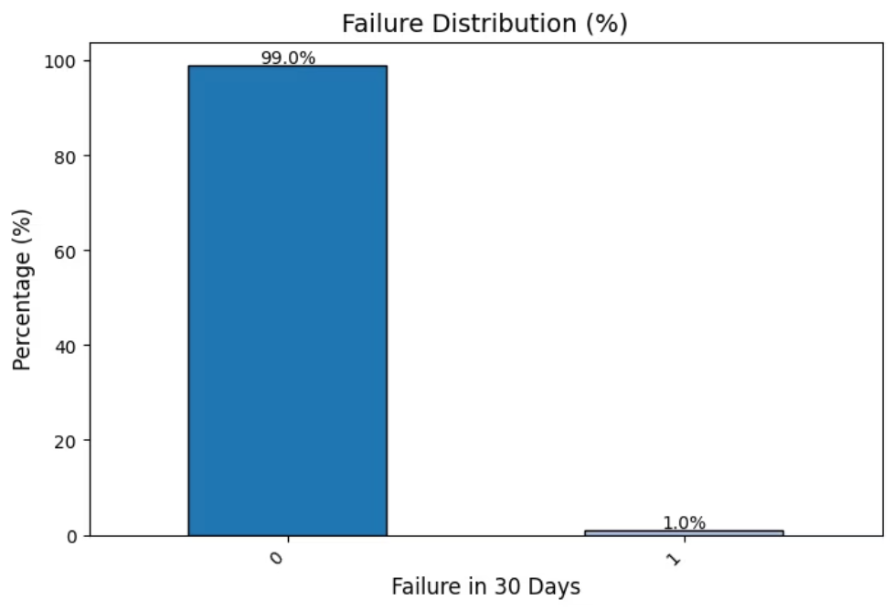
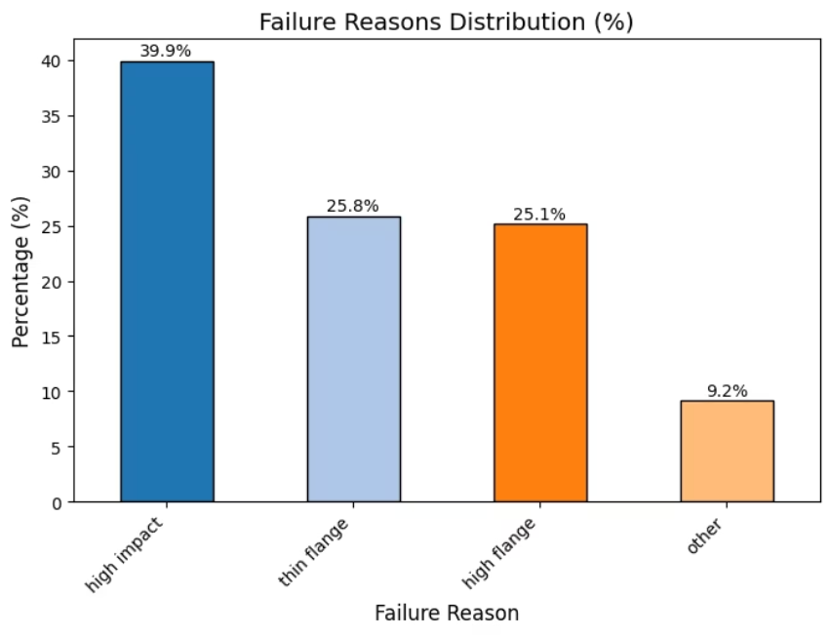
Data Preprocessing
Key Processing Steps
1
Target Variable Encoding
2
Temporal Alignment
Replaced missing failurereason entries with "not failed" classification to clearly distinguish healthy components from failure states
Standardized all date fields to monthly granularity ensuring consistent sensor-failure mapping across the entire dataset
3
Missing Value Treatment
Implemented strategic imputation with zero values for engineered features, leveraging tree-based models' ability to interpret "no signal" as informative
Class Imbalance Handling:
Extensive testing of SMOTE and resampling techniques revealed overfitting issues
Final model achieved superior performance without resampling by leveraging anomaly features to capture minority failure patterns effectively
Notes:
The data is highly imbalanced—about 99% healthy and 1% failed. We filled missing failure reasons with “Not Failed,” aligned all records monthly for consistent time mapping, and imputed missing numeric values with 0 so that tree-based models interpret “no signal” meaningfully. We tested resampling and SMOTE but found they caused overfitting. Instead, we leveraged anomaly features, which captured minority-class behaviour naturally and improved model performance.

Slide 7
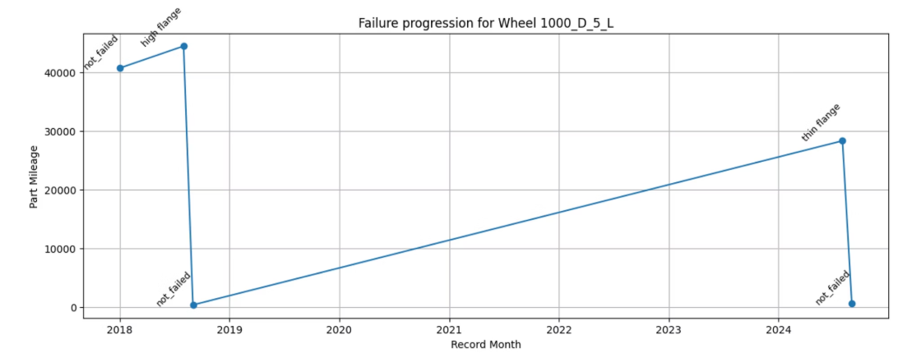

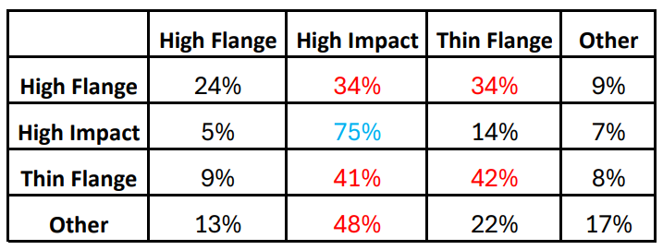

EDA: Failure Sequence Analysis
Multiple Failure Patterns
3,627 wheels (19% of total unique wheels) experienced multiple failures over their operational lifetime, revealing complex degradation patterns
Next Failure
Current Failure
Key Finding: High Impact is the dominant end state
Failure Transition Probability Matrix
Notes:
We noticed 19% of wheels experienced multiple failure types as shown in fig.Using combination of 4 unique keys we have uniquely identified a wheel. By constructing failure sequences, we derived a transition probability matrix between current and next failure types.

Slide 8
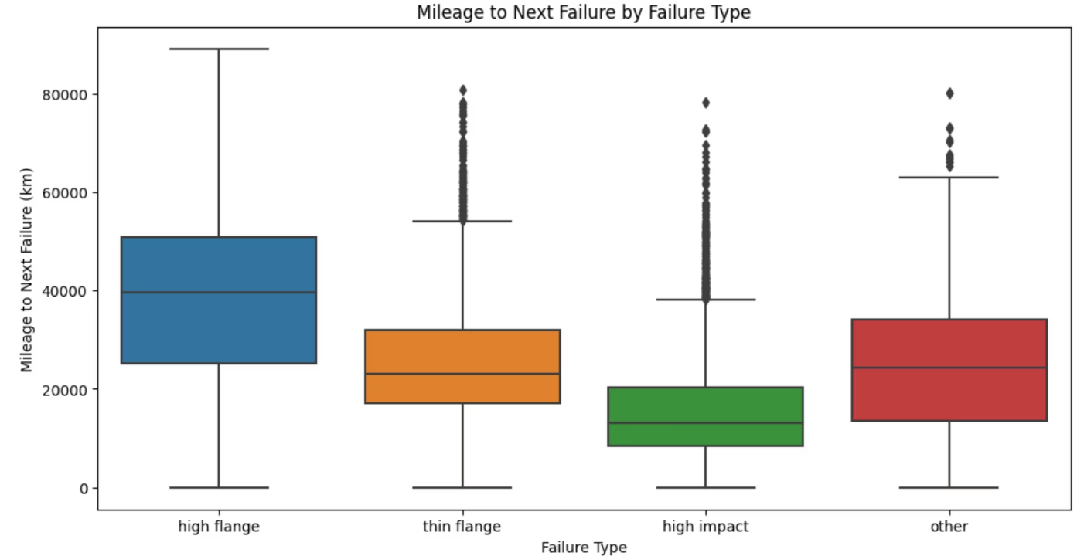

EDA: Mileage to Next Failure
High Impact
Next failure occurs within 10–15 thousand km, indicating rapid degradation
Thin Flange
Subsequent failure occurs after 20–30 thousand km, indicating moderate degradation
High Flange
Next failure occurs after 40–50 thousand km, showing slower degradation
Critical Insight: High-impact failures require immediate inspection and proactive maintenance to prevent rapid recurring damage
Notes:
High Impact serves as the dominant end state, with most other failure types eventually transitioning into it. Once a wheel experiences a High Impact failure, it tends to degrade rapidly into subsequent failures. Therefore, timely maintenance of flange-related issues is essential to minimize transitions into High Impact and prevent accelerated deterioration.

Slide 9
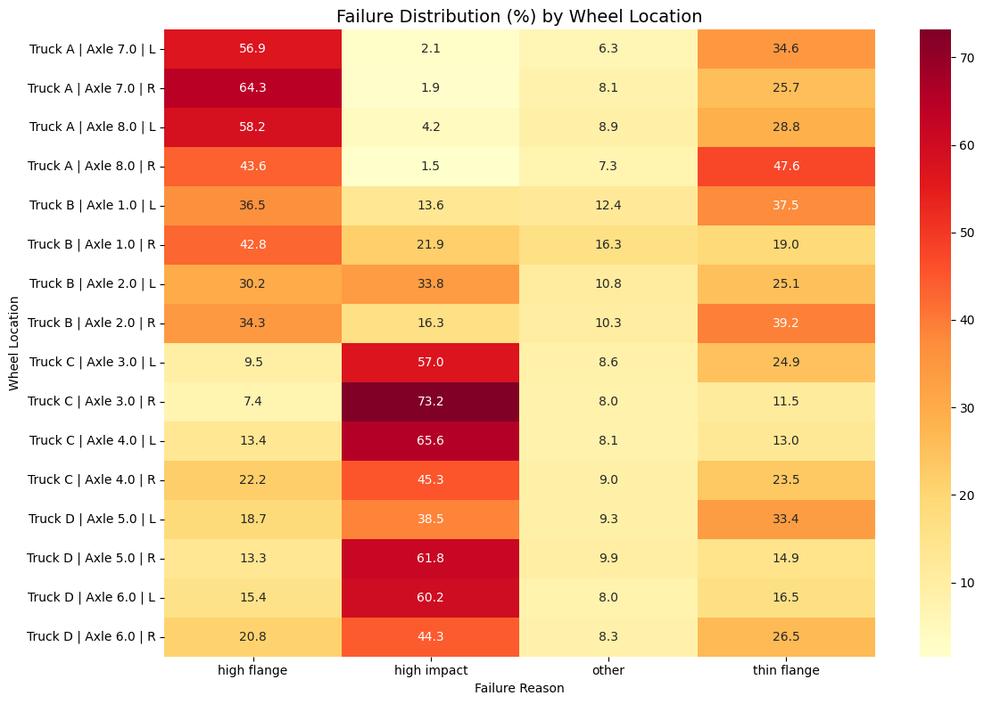
EDA: Failure Distribution By Wheel Location
Trucks C and D need closer monitoring for
High Impact Failures
Trucks A and B require regular checks for
Flange Thickness degradation
Notes:
This heatmap shows the distribution of failure types across different wheel locations.
We can see a clear pattern:
Trucks C and D show a higher concentration of high-impact failures — indicating these wheels experience more shock loads and need closer monitoring for impact-related damage.
On the other hand, Trucks A and B have more high flange and thin flange failures, suggesting progressive flange wear and the need for regular thickness inspections.
Overall, this helps us identify truck-specific maintenance focus areas
Although these EDA steps were beyond the direct scope of predictive modeling, we performed them to gain deeper insights into failure behavior..

Slide 10
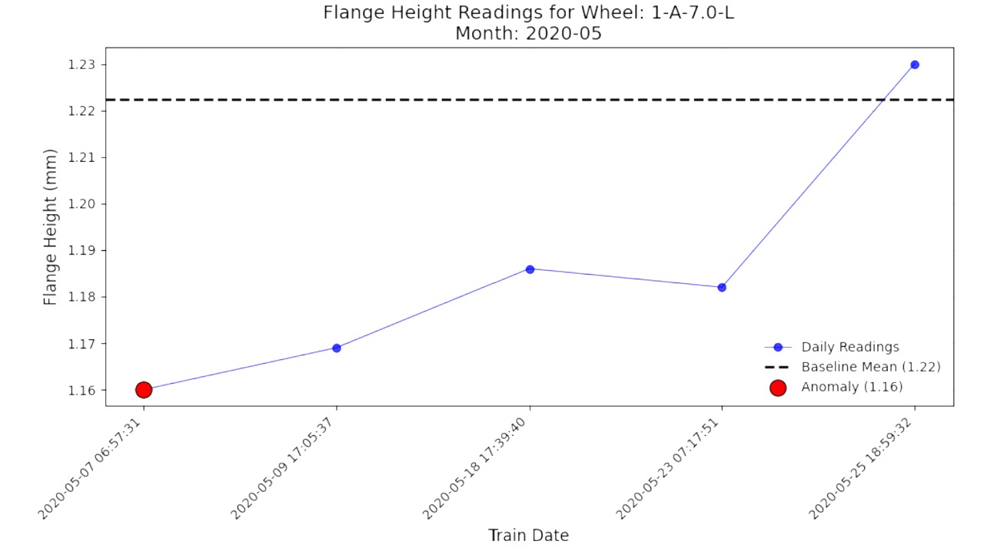
Feature Engineering Pipeline
01
Baseline Features
Raw equipment and sensor data as foundation
02
Anomaly Features
Flagged monthly abnormal readings
03
Aggregated Features
Computed monthly statistics (min, max, std, mean, median)
04
Lag Features
Captured temporal behavior and failure progression (past 6 months)
Notes:
Initially, lag0 features were included, which led to data leakage. After removing them, the model still achieved comparable performance.

Slide 11
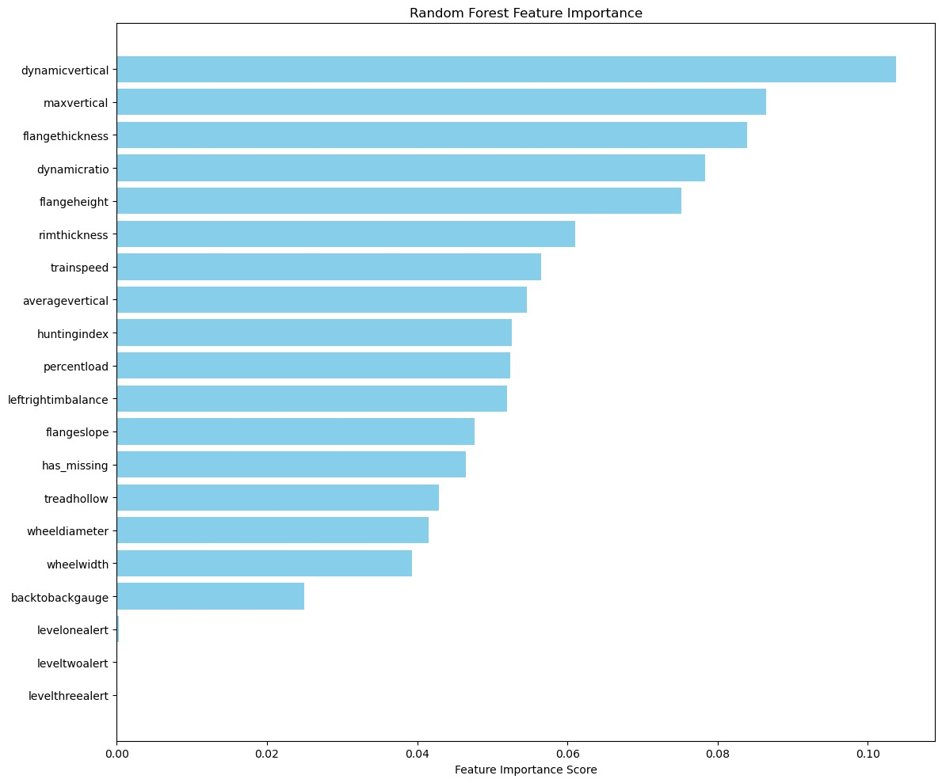
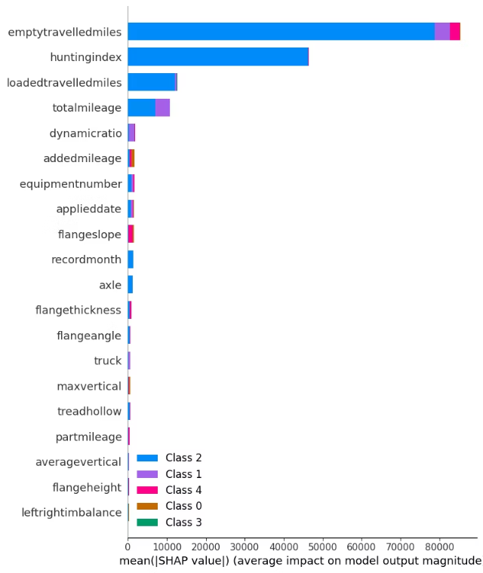
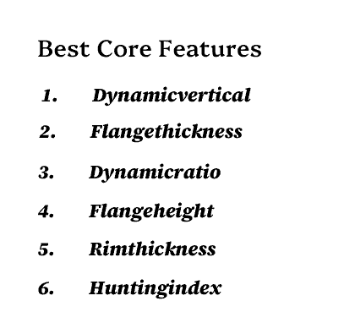
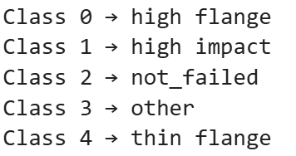

Feature Selection: SHAP + RF + Domain
Feature Importance using Random Forest
SHAP* Value Analysis
Notes:
Mileage feature excluded from training data as it is not present in test set; avoids leakage
Partmileage included - Available for test data; improves accuracy
*SHAP (SHapley Additive exPlanations) is a game theoretic approach to explain the output of any machine learning model
Notes:
We used Random Forest importance and SHAP analysis, refined through domain understanding. Key predictive features were Dynamic Vertical, Flange Thickness, Dynamic Ratio, Flange Height, Rim Thickness, and Hunting Index. We excluded total mileage to prevent data leakage but retained part mileage, which improved accuracy and consistency across test data.

Slide 12



Model Training & Configuration
Objective
Train a classification model for failure prediction using advanced machine learning techniques
Model Choice: LightGBM
Selected for high performance on tabular data, efficiency, and robust handling of sparse feature sets
Training & Validation Strategy
Data split: 80% training, 20% validation
Used early stopping based on multi_logloss (patience: 100 rounds) to prevent overfitting
Hyperparameter Tuning
Optimized Parameters:
Independent Variables
Target Variable
Objective: multiclass (5 classes)
Failure Reason:
High Flange
Thin Flange
High Impact
Others
Not Failed
Estimators: 3000 (with early stopping)
+
Anomaly Features
Lagged Features
Aggregated Features
Learning Rate: 0.01
Num Leaves: 64
Feature Fraction: 0.8
Bagging Fraction: 0.8
Regularization: α=1.0, λ=1.0
Log Loss = 0.02544
Notes:
We also experimented with Random Forest, XGBoost, and LSTM, but LightGBM offered the best trade-off between performance and interpretability.

Slide 13



Key Recommendations
High Impact Failure Prioritization
Prioritize maintenance or replacement for wheels showing early High Impact patterns (identified as the most critical
and quickly leads to next failure type)
Optimized Inspection Intervals
After High Impact failure → re-inspect every 10–15k km
After Thin Flange failure → re-inspect every 15–20k km
After High Flange → re-inspect every 25–30k km
Failure Distribution w.r.t location
Trucks C and D need closer monitoring for High Impact shocks
Trucks A and B require regular checks for Flange Thickness degradation
Integrating additional sensors
Thermal Imaging: Detects overheating and friction hotspots for early fault detection
Ultrasonic Testing: Captures internal cracks and material fatigue before surface damage appears
Notes:
We hope our work contributes to ongoing efforts in predictive maintenance across the rail industry.
Thank you for your time and for giving us the opportunity to present our solution.

Slide 14
THANK YOU

